Slide 1

Sprocket Bike Shop
ISSS621 20222023T2 G2 – GROUP 2
Srivatsan Madapuzi Srinivasan

Slide 2

Table of Contents
- Introduction - Customer Segmentation - Product Segmentation - Recommender System - Reactivation model - Conclusion
01
02
03
04
05
06

Slide 3

01
Introduction
Lets start with introduction, Scope of the project and data set used

Slide 4

Introduction
Sprocket Central Pty Ltd, a medium-sized business that specialises in high-quality bikes and accessible cycling accessories to riders
The company has built a strong reputation for producing quality and reliable products

Slide 5
Scope of the Project
Aim
Motivation
Tasks
To boost their marketing strategies and support their new venture in digital sales as opposed to primarily in store transactions
It’s the biggest planet in the Solar System
Venus has a beautiful name, but it’s hot

Slide 6
Data Sets
Transactions
Rows 19803
Columns 15
Dtypes datetime64[ns](1), float64(6), int64(3), object(5)
Col Names transaction_id, customer_id, Transaction_date, product_id, online_order, order_status, brand, product_line, product_class, product_size, list_price, standard_cost, Profit, Margin, Number of Unique Brands Bought
Full_Demo
Rows 3996
Columns 21
Dtypes datetime64[ns](2), float64(3), int64(5), object(11)
Col Names customer_id, last_name, gender, first_name, gender_val, past_3_years_bike_related_purchas es, 2017_bike_related_purchases, last_transaction_date, DOB, Age, Age Group, job_industry_category, wealth_segment,
owns_car, tenure, Number of Unique Brands Bought, address, postcode, state, country, past_purchase_range
NewCustomerList
Rows 1000
Columns 16
Dtypes datetime64[ns](1), float64(6), int64(3), object(5)
Col Names first_name, last_name, gender, past_3_years_bike_related_purchases, DOB, Age, Age Group, job_title, job_industry_category, wealth_segment, owns_car, tenure, address, postcode, state, country

Slide 7
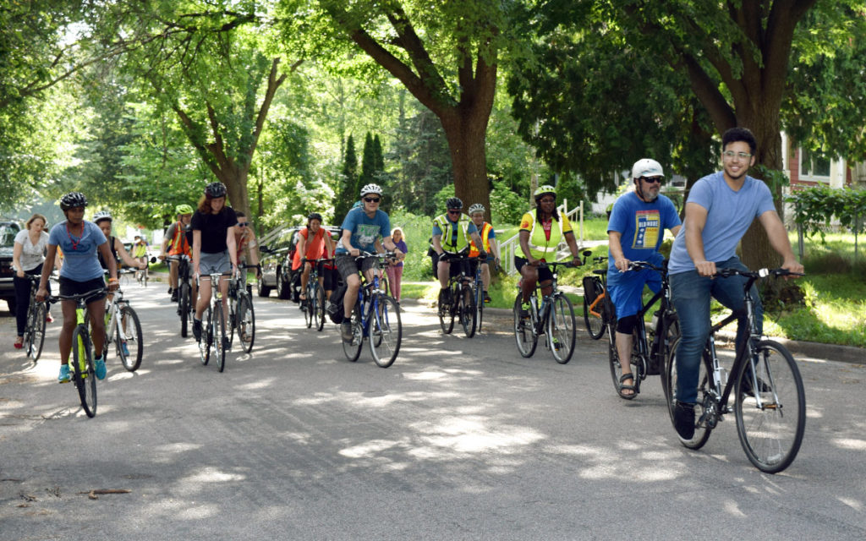
Customer Segmentation
02
How do we describe our customers

Slide 8
Customer Segmentation Progress
Data Cleaning
Exploratory Data Analysis
Behavior Variable Deriving
K-means /
Hierarchical
Clustering
Cluster
Analysis
Target Marketing
Notes:
Here is the customer segmentation analysis flow.
The first step is data preparation and EDA, Our team members have already briefed us on our findings from the EDA.
The next step is behaviour variable deriving, which is used as input for clustering modelling. We use two clustering algorithms in this section, K-means and Hierarchical clustering, to segment our customers. This allows us to group our customers into similar groups based on their behaviours.
Once we have clusters, we can conduct cluster analysis based on clustering result. This step helps us to understand the characteristics of each cluster and their potential needs and preferences.
Finally, with this information, we can develop targeted marketing strategies that are tailored to the specific needs and preferences of each cluster.

Slide 9
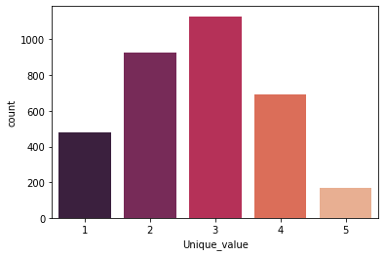
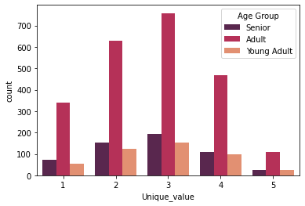
Customer Details
Number of Unique brands per Customers in 2017
Number of Customers among Age Groups.
Most of the customers at Sprocket tend to buy 3 unique brands.
Adult age group is the most prominent and promising customers among other age groups.

Slide 10
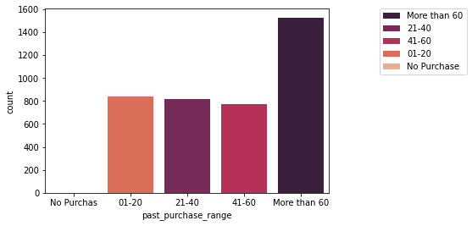
Customer Details – Past Purchases Range
Number of Customers by Past Purchase in 3 years Range
The above graph indicates that in past 3 years a maximum of 1600 customers have more than 60 bike related purchases at Sprocket bike. The next highest number of transactions in the past 3 years is around 800 customers who purchased only 1 to 20 bikes and related accessories.
In terms of the number of past purchases, it indicates that the types of customer at Sprocket vary a lot.

Slide 11
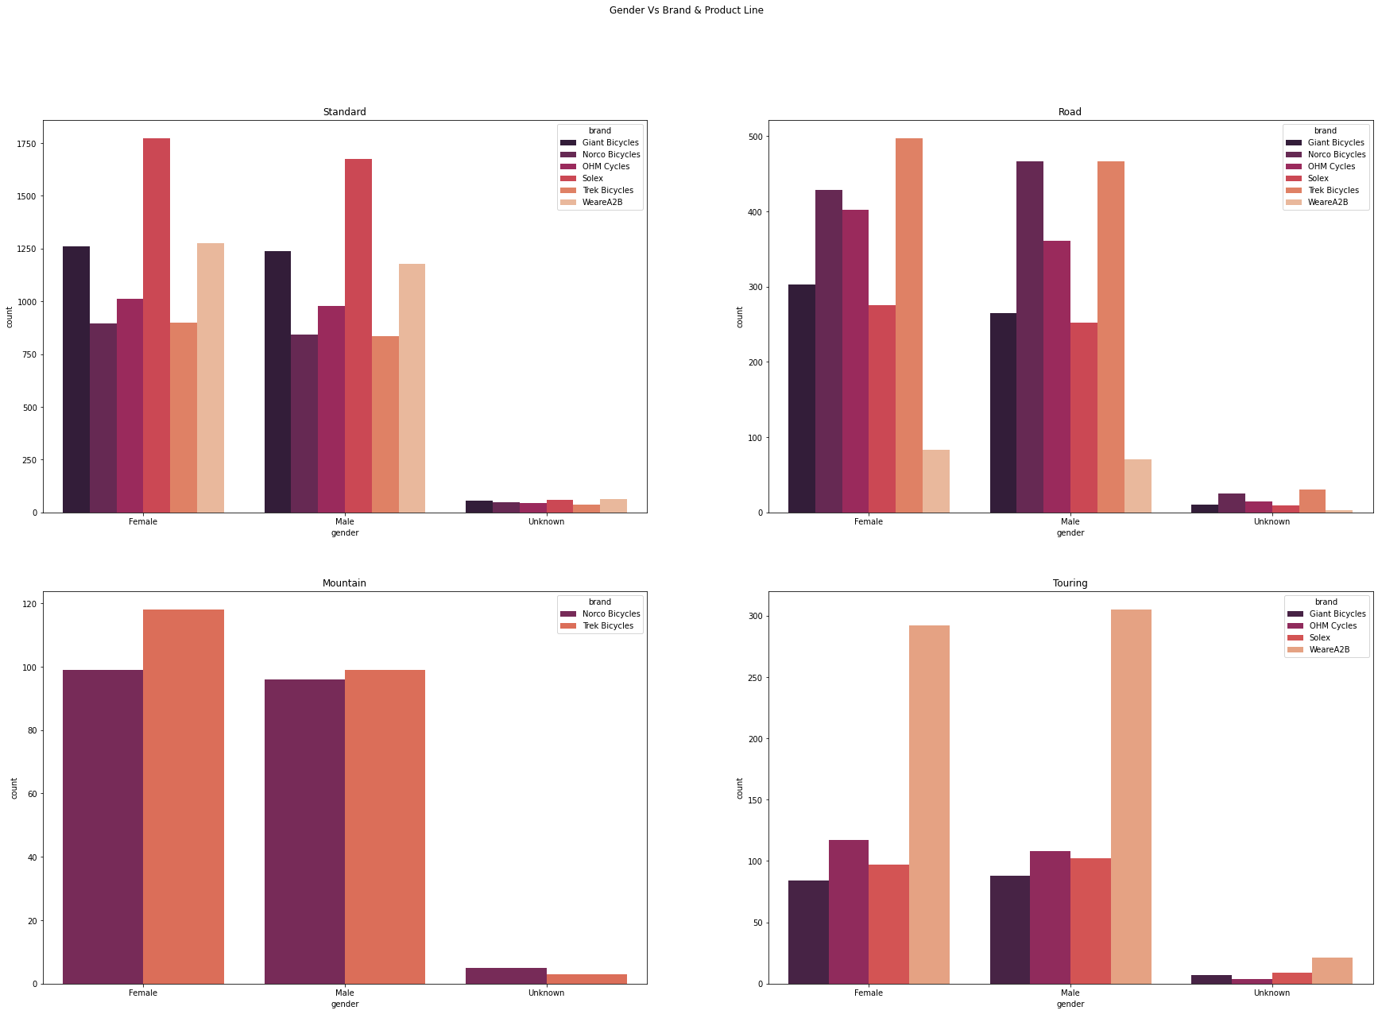
Customer Details – Gender
In most of the categories, Female customers are the most prominent ones.
Male customers prefer touring bicycles over female customers.
For the brand Norco Bicycles, in 2017 male customers have bought the road type bikes more than the female customers.
Number of Transactions by Customer Vs Brand & Product Line

Slide 12
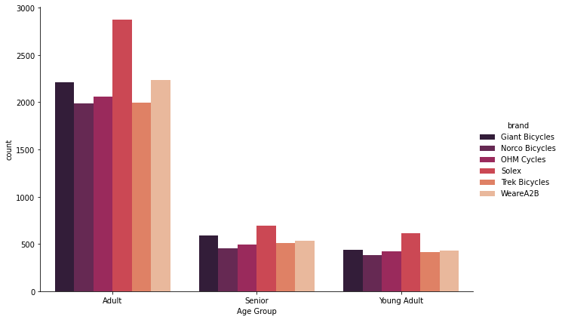
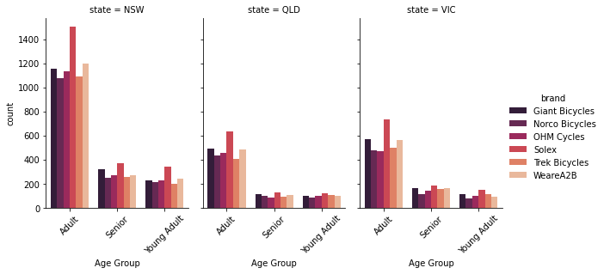
Customer Details – Age Group
Number of Transactions by Customer Age Vs Brand
Number of Transactions by Customer Age by State Vs Brand
WeareA2B is the second most preferred brand among Adult customers, but Seniors and Young Adults prefer Giant Bicycles as the second go-to brand.
New South Wales has a very high transaction count under Adult age group compared to other states in Australia.

Slide 13
RFM and Purchase Choice
Recency:
Frequency
Monetary
Brand Diversity
Product_line Diversity
Product_size Diversity
How recently a customer has made a purchase
How often a customer makes a purchase
How much money a customer spends on purchases
How many brand a customer has purchased
How many types of product_line a customer has purchased
How many types of product_size a customer has purchased
Notes:
Here is the behaviour variable we derived, RFM and Customer Choices
For RFM, which are commonly used for customer segmentation and help us to identify who we need to target market.
Recency refers to how recently a customer has made a purchase
Frequency refers to how often a customer makes a purchase
Monetary value refers to how much money a customer spends on purchases.
Another important part of our analysis is customer choice, which includes brand diversity, product line diversity, and product size diversity. These variables help us to identify customer preferences for product brand, product line, and product size.
In terms of product brand, there are five different brands in our Transactions dataset: Gaint, Norco, OHM, Solex, Trek, and Weare A2B.
For product line, there are four different types: Mountain, Road, Standard, and Touring.
And for product size, there are three different types: Large, Medium, and Small.
By analyzing customer choice, we can select the products which can use for targeted marketing. This allows us to tailor our marketing strategies to the specific needs and preferences of each customer segment.

Slide 14
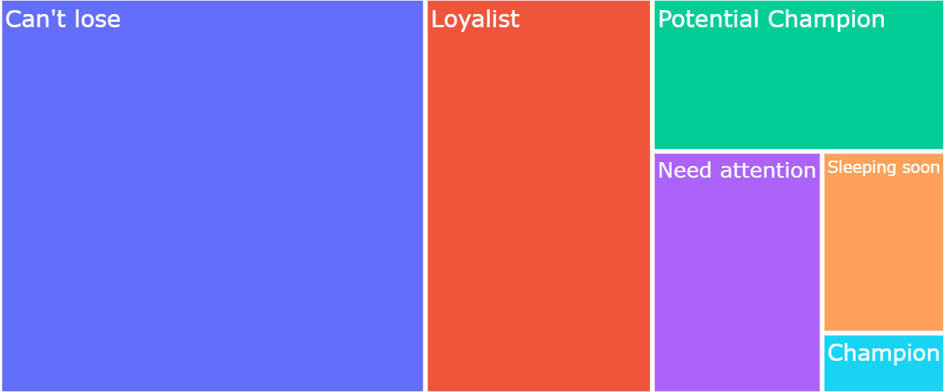
Customer Clustering - RFM
High Value
45% Medium Value
24% High Value
12% High Value
Champion
Potential Champion
Loyalist
11% Low Value
6%
Low Value
Medium Value
Can't lose
Low Value
Need attention
2% King
Sleeping soon
Who is the marketing target?
- Can’t lose Segment: 45% of existing customer base & 37% revenue contribution
- Loyalist Segment: 24% of existing customer base & 31% revenue contribution
- Need attention Segment:11% of existing customer base & about 3 months not visit shop
Notes:
Using K-means clustering method with RFM as input, we’ve identified six customer segments: Champion, Potential Champion, Loyalist, Can't Lose, Need Attention, and Sleeping Soon.
The Champion segment consists of our most valuable customers, with highest frequency, highest monetary value, and most recent visits.
The Potential Champion and Loyalist segments share similar characteristics, with high frequency, high monetary value, and recent visits.
The Can't Lose segment is the largest component of our customer base, with medium frequency, monetary value, and recency.
The Need Attention and Sleeping Soon segments belong to low value customer group, due to low frequency, monetary value, and recency.
Assuming we only have limited marketing budget, our strategy is to prioritize the following three segments:
First, the Can't Lose segment, which accounts for 45% of our customer base and 37% of revenue contribution. And they have potential to become high-value customers.
Second, the Loyalist segment, comprising 24% of our customer base and 31% of revenue contribution. They have space to grow and could become Potential Champion or even Champion customers.
Finally, the Need Attention segment, representing 11% of our customer base and having not visited our shop in about 3 months, requires our attention to avoid losing them.
Next, we can tailor the marketing based on our targeted customers.
Note:
Customer Segment based on RFM:
Champion Customer [clusters 6] 2% - highest frequency, highest monetary_value and most recent visit
Potential Champion Customer [clusters 2,3] 12% - higher frequency, higher monetary_value and more recent visit
Loyalist Customer [clusters 4, 9] 24% - high frequency, highest monetary_value and recent visit
Can't loose Customer[clusters 0,5,8] 45% - Medium frequency, Medium monetary_value, Medium recent visit
Need Attention Customer [clusters 1] 11% - low frequency, low monetary_value and low recent visit
Sleeping Soon customer [clusters 7] 6% - lowest frequency, lowest monetary_value and long time no visit

Slide 15


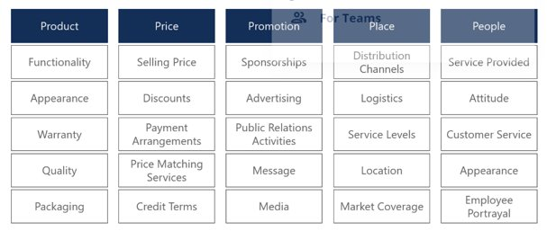
Promotion Marketing Method
Social Media Marketing
Email Marketing
Notes:
In this project, we will mainly focus on and discuss two main marketing methods:
Social media marketing: We will use popular social media platforms such as Facebook, Instagram, tiktok and Twitter to connect with our target audience and display our product.
Email marketing: We will create targeted email campaigns with personalized messaging to reach specific segments of our audience. This will help us to keep our customers informed about new products, promotions, and events, as well as to maintain ongoing communication with them.

Slide 16
Customer Clustering – Purchase Choice
- What should we market?
Based on history purchase choice to decide use what brand , Product_line and Product size product
for target marketing.
Purchase Choice Cluster | Brand Diversity | Product_line Diversity | Product_size Diversity
2 | High | High | High
11 | High | High | Medium
3,4 | High | Medium | High
7,9 | High | Medium | Medium
1 | High | Low | High
8 | Medium | Medium | Medium
5 | Medium | Medium | Low
6 | Low | Low | Low
10 | Medium | Low | Medium
Brand Diversity: Purchased Brand Type 4,5 – High, 3 – Medium , 1,2 – Low
Product_line Diversity: Purchased Product_line Type 3 – High, 2 – Medium,1 – Low
Product_size Diversity: Product_size Diversity Type 3 – High, 2 – Medium,1 – Low
Notes:
To determine which products to market to our target customers, we train Hierarchical clustering modeling with customer choice as input, which has resulted in 11 clusters. We further grouped these clusters into high, medium, and low categories based on their level of brand diversity, product line diversity, and product size diversity.
For example, customers in the high diversity cluster are more willing to try different products, so we can target them with advertisements for the latest products.
Another example - customers in cluster 1, we can see that they prefer a specific product line but are open to trying different brands and product sizes. Therefore, we can introduce different brand and product size options but still focus on the preferred product line based on their transaction history.
Using this approach, we can identify the preferences of our target customers and tailor our marketing efforts accordingly to promote the most relevant products.

Slide 17
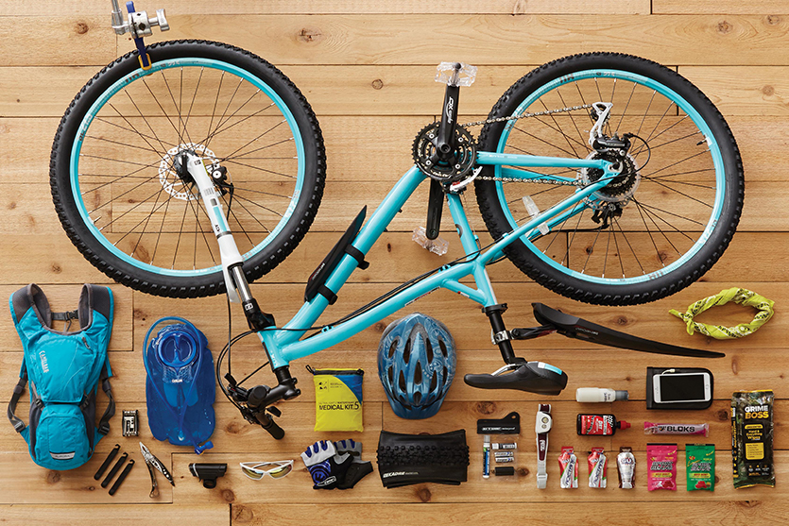
Product Segmentation
03
How can we better understand the Sprocket’s product offering

Slide 18
Customer Segmentation -Behaviour Analysis
Targeted marketing for existing customer
- Who is the marketing target?
- What should we market?
Notes:
In this section, I will discuss customer segmentation based on customer behaviour and how it is linked to our target marketing activities. By exploring customer segmentation, we can answer two important questions:
The first question is "Who is our marketing target?" Customer segmentation allows us to group our customers based on shared characteristics. By doing so, we can identify which segments are the ones that have the greatest potential for growth or need more attention.
The second question is "What should we market?" By understanding the behavior of each customer segment, we can identify their specific needs and preferences. By tailoring our marketing messages to each segment's specific needs and preferences, we can create more effective marketing campaigns.
we try to reach the right audience with the right message, by exploring these two questions.

Slide 19
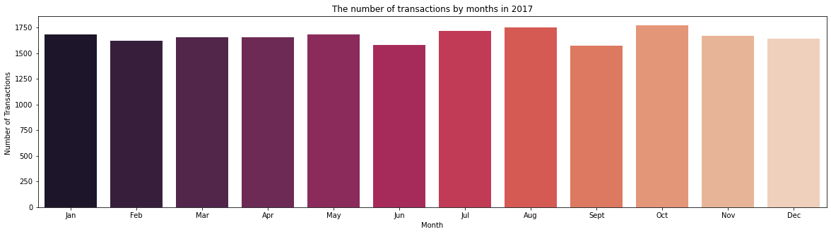
Exploratory Data Analysis (Transaction Data)

Slide 20
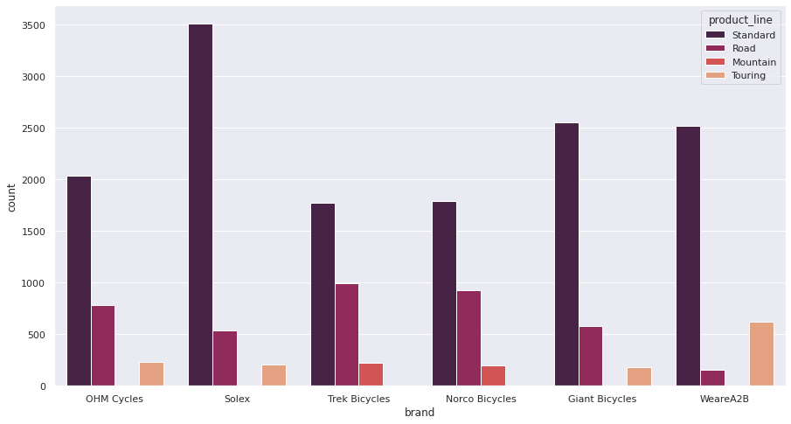
Exploratory Data Analysis (Transaction Data)

Slide 21
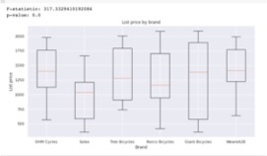
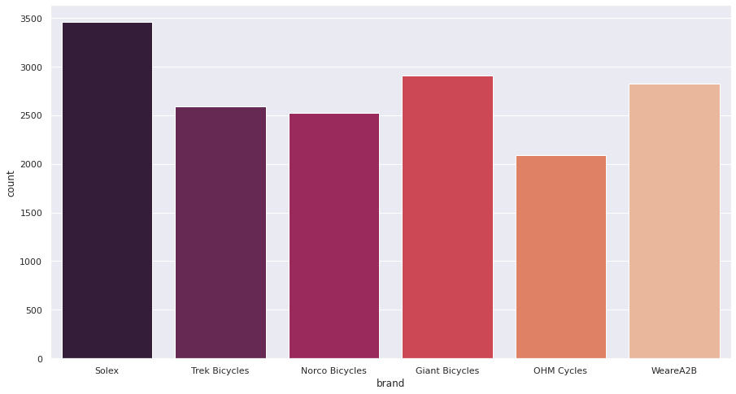
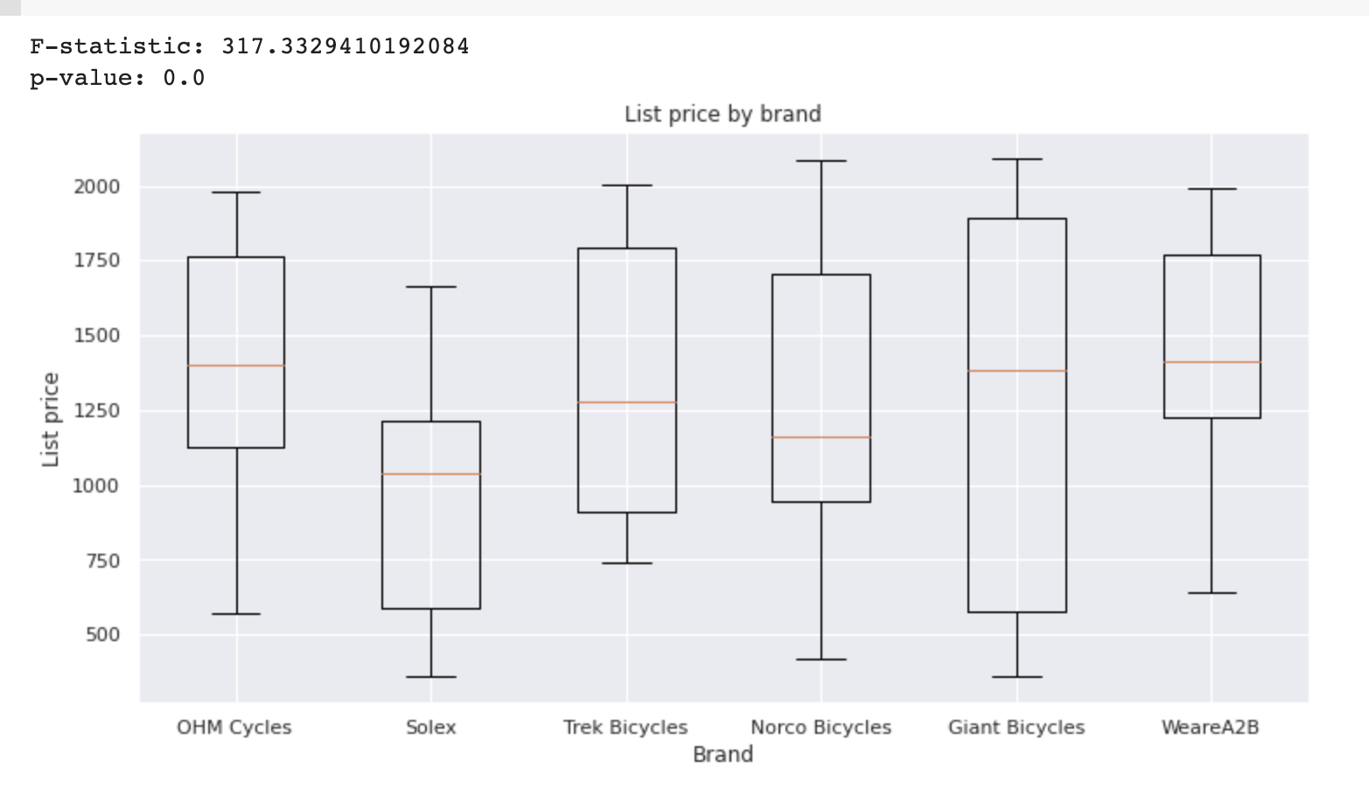
Bike Brand Distribution
BRAND DISTRIBUTION
ANOVA TEST – MEAN PRICE
Solex Bikes is the top brand based on number of sales (disregarding accessories)
Even if Solex is the top bike brand, it is also the cheapest based on average list price

Slide 22
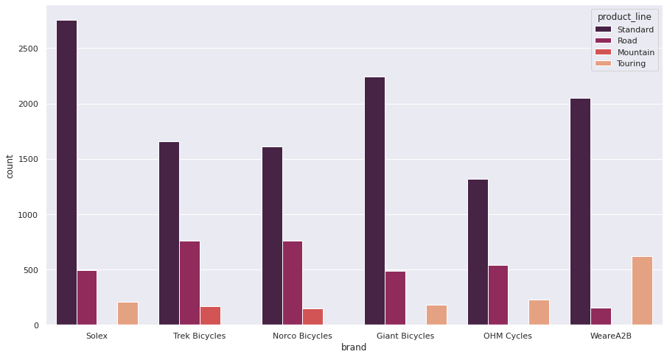
Bike Product Line Distribution
Standard Bikes are overwhelmingly the top product line amongst the different product lines
It can be assumed with the high purchase of standard bikes, that bikes are primarily used for transportation (as compared to specialized road and mountain bikes)

Slide 23
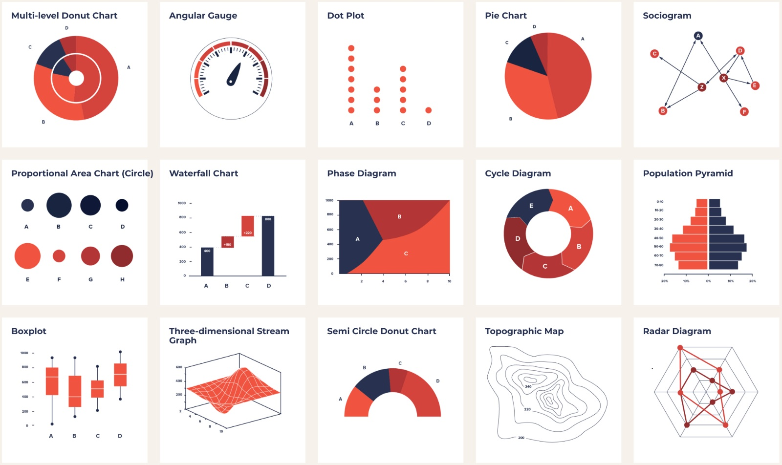
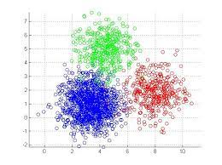
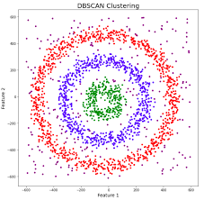
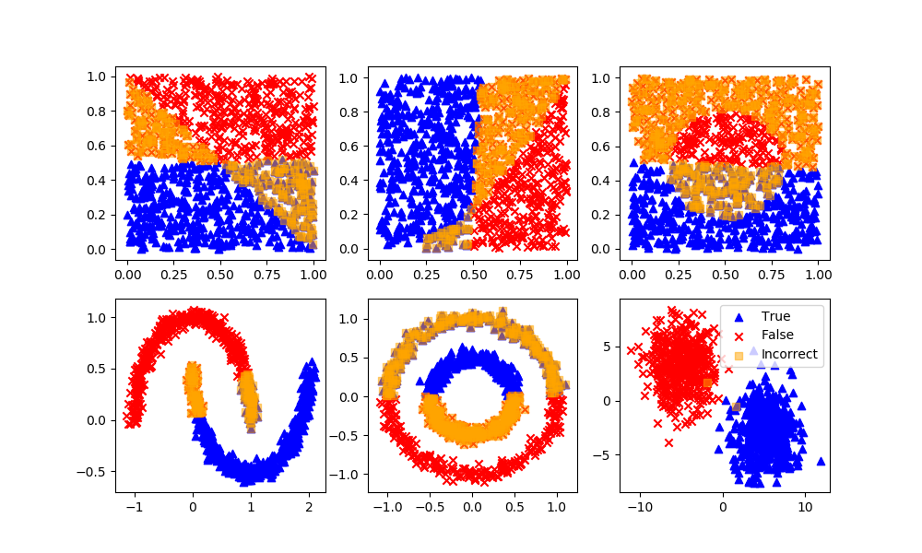
Methodology
EXPLORATORY DATA ANALYSIS
CLUSTERING METHODOLOGY
K Means
DBSCan
GMM
Tabular and Visual representation and analysis
Identify the best clustering methodology by comparing their individual Silhouette Score* per number of cluster
* Silhouette Coefficient or silhouette score is a metric used to calculate the goodness of a clustering technique. Its value ranges from -1 to 1 (clustered well to not clustered well.

Slide 24
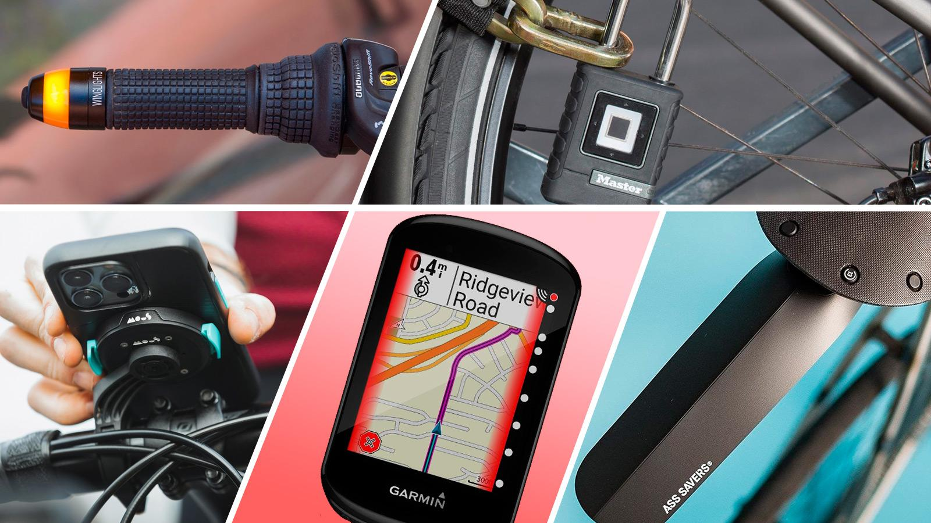
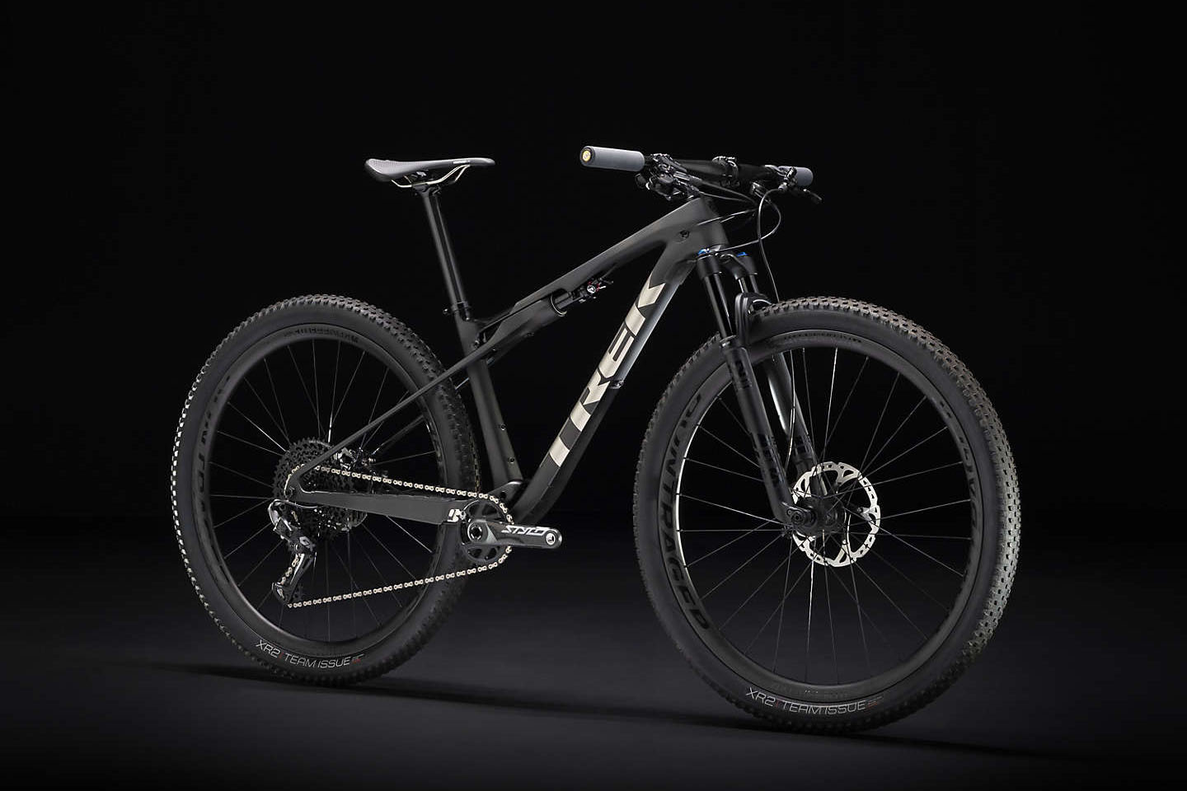
Identifying Product Type
DIFFERENT PRODUCT OFFERING
Bike Accessories
Bicycles
Bike-related tools and applications such as helmets and shoes to GPS monitoring devices
Tiered by pricing level (Low, Mid, High Priced)
Can be described in different types (Standard, Mountain, Road and Touring)
* This section identifies if the product is an accessories but cannot identify what specific type of accessory

Slide 25
Identifying Product Type
METHODOLOGY
IDENTIFY CLUSTERING METHODOLOGY
Identify Clustering Methodology
Perform Clustering
Segment Product IDs
INSIGHT
K Means Clustering methodology generally have a higher Silhouette Score
* List Price is used to cluster to identify product type as price list is the closest representation of market standard price

Slide 26
Identifying Product Type
METHODOLOGY
IDENTIFY NUMBER OF CLUSTER
Identify Clustering Methodology
Perform Clustering
Segment Product IDs
INSIGHT
Visually, through elbow method, 4 is the optimal number of clusters

Slide 27
Identifying Product Type
METHODOLOGY
CLUSTERING – PRODUCT TYPE IDENTIFICATION
Cluster | Ave List Price | No. of Transactions | Product Type
0 | 324.104950 | 3988 | Accessory
1 | 1786.114907 | 5374 | High Priced Bike
2 | 751.693596 | 4458 | Low Priced Bike
3 | 1286.899489 | 5983 | Mid Priced Bike
Identify Clustering Methodology
Perform Clustering
Segment Product IDs
* Defining product type is from domain knowledge
** Each Product ID will be assigned a cluster

Slide 28
Product Sales Performance
METHODOLOGY – QUADRANT ANALYSIS
Q1 – Profitable but Niche
Q2 – Cash Cows
Products listed here needs sales and marketing support
Products listed here need minimal to no support
QTY
Q3 – Need Assessment
Q4 – Economical
Products listed here are to assessed if support is needed or to be dropped
Products listed here need to reassess ways to increase profitability
Profitability

Slide 29
Product Sales Performance
METHODOLOGY
IDENTIFY CLUSTERING METHODOLOGY
Identify Clustering Methodology
Perform Clustering
Segment Product IDs
INSIGHT
K Means Clustering methodology generally have a higher Silhouette Score
* List Price is used to cluster to identify product type as price list is the closest representation of market standard price

Slide 30
Product Sales Performance
METHODOLOGY
IDENTIFY NUMBER OF CLUSTER
Identify Clustering Methodology
Perform Clustering
Segment Product IDs
INSIGHT
Visually, through elbow method, 14 is the optimal number of clusters

Slide 31
Product Sales Performance
METHODOLOGY
QUADRANT ANALYSIS
Identify Clustering Methodology
Perform Clustering
Segment Product IDs
[clusters - 9]
[clusters - 3, 4, 6, 7, 8]
[clusters - 0, 5]
[clusters - 1, 2]

Slide 32

Simple Recommender System
04
How can we improve customer experience

Slide 33
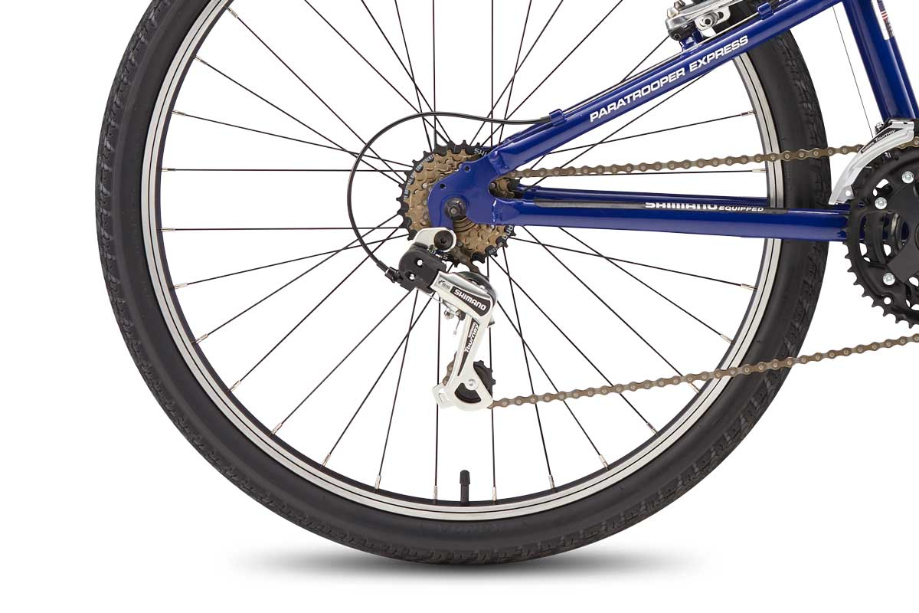
Why Build a Recommender?
The two sides of the wheel
Customers new to hobby may not know what they want or what is best
Niche, hobby shop
Lesser transactions, specific buyers, maintain relationship with customers

Slide 34
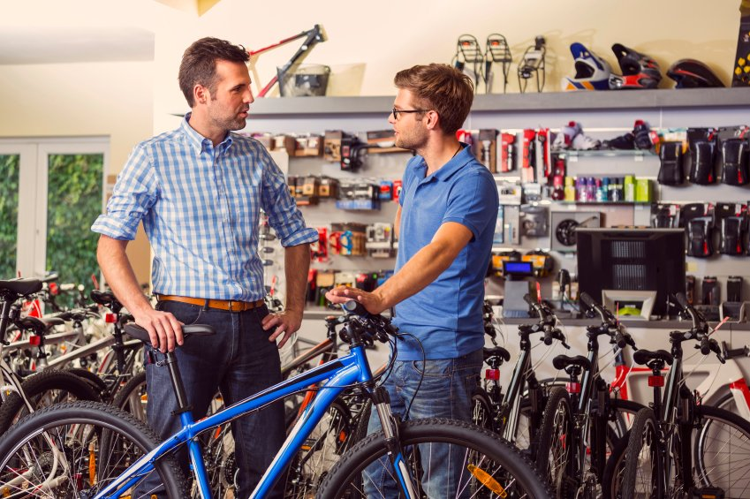
Two Recommenders
New Customer
Old Customer
New customers DO NOT have transactions yet
Demographic Filtering
Notes:
The idea for the new customer recommender came from the available data in our dataset.

Slide 35


Two Recommenders
New Customer
Old Customer

Slide 36
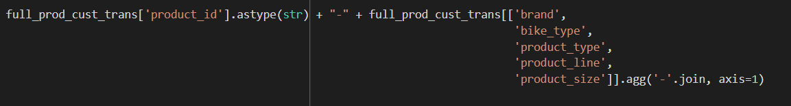
Cluster | Ave List Price | No. of Transactions | Product Type
0 | 324.104950 | 3988 | Accessory
1 | 1786.114907 | 5374 | High Priced Bike
2 | 751.693596 | 4458 | Low Priced Bike
3 | 1286.899489 | 5983 | Mid Priced Bike
Bike Accessories
Bicycles
Bike-related tools and applications such as helmets and shoes to GPS monitoring devices
Tiered by pricing level (Low, Mid, High Priced)
Can be described in different types (Standard, Mountain, Road and Touring)

Slide 37
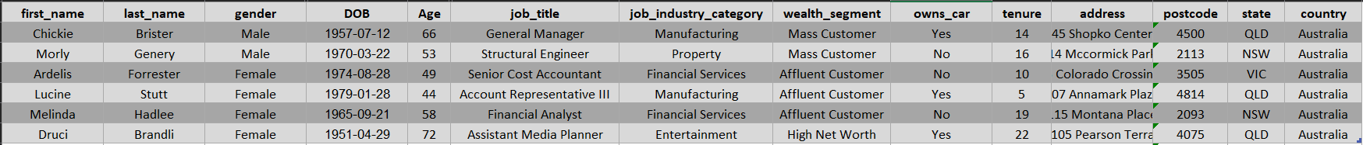
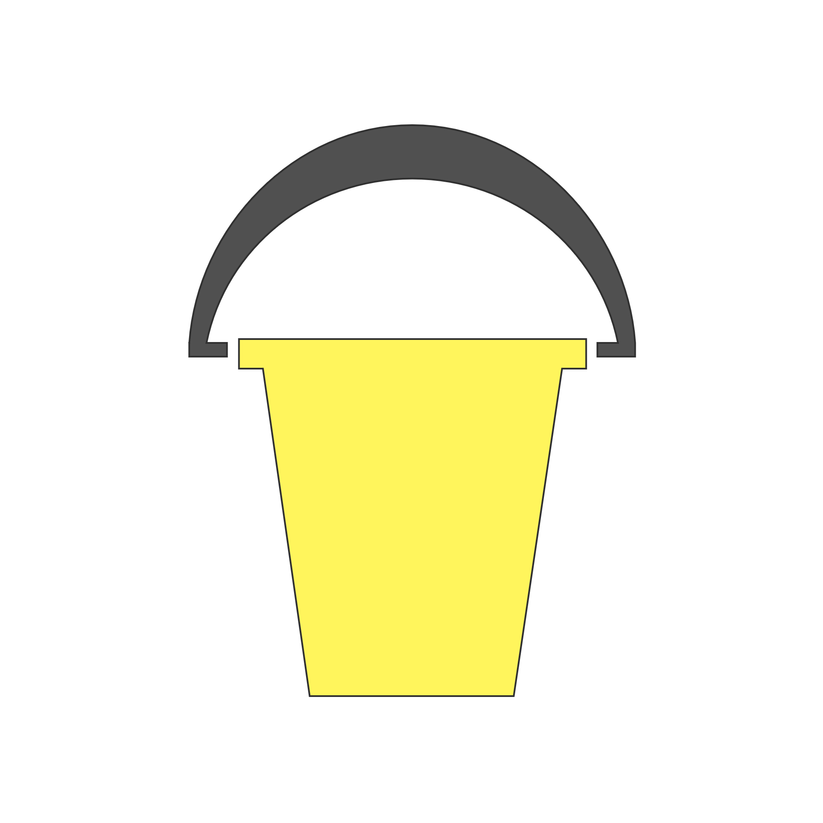
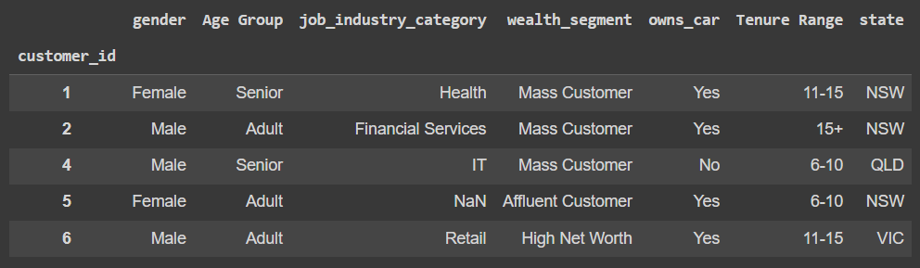







Recommender for New Customers
Required Data
Demographic data of old customers for clustering and demographic data of the new customer
Age Group
Tenure
Tenure Range
Age
Demographic Variables
Age Group
Wealth Segment
Gender
Job Industry
Car Owner
State
Tenure Range

Slide 38
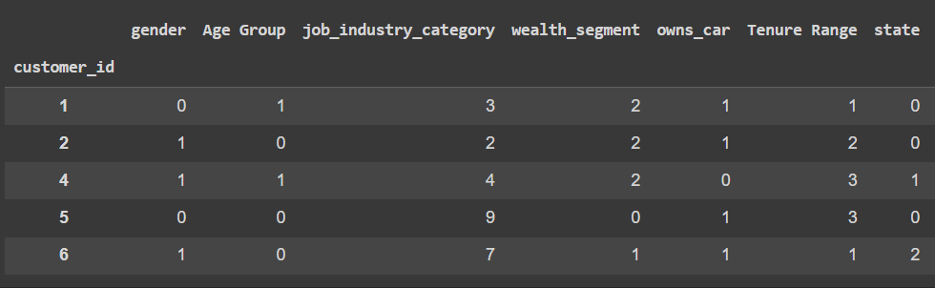


Recommender for New Customers
Required Data
Clustering
Label Encoding
LabelEncoder()
0
1
2
3
Demographic data of old customers for clustering and demographic data of the new customer
A
B
C
D
Categorical
Numerical
Demographic Variables
Age Group
Wealth Segment
Grouping similar customers according to their demographic data
Gender
Job Industry
Car Owner
State
Tenure Range

Slide 39
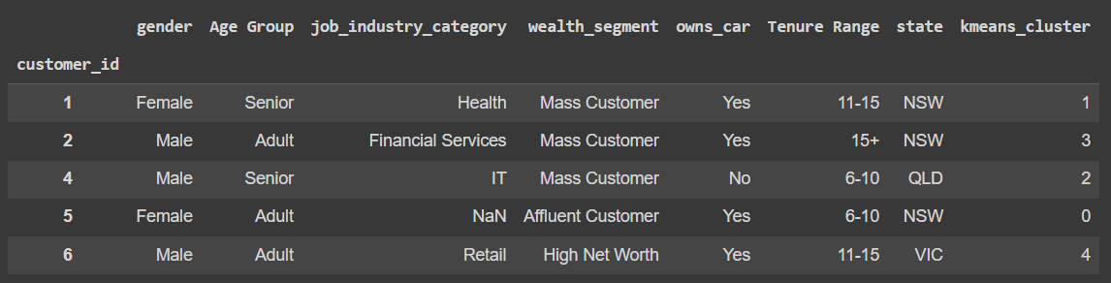
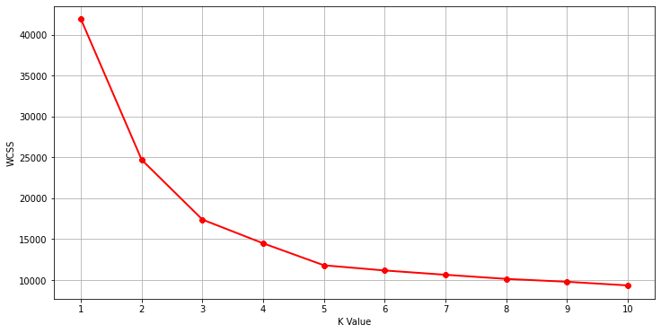
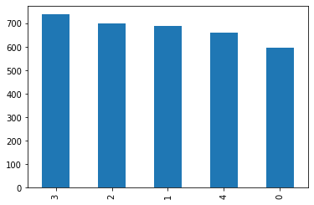
Recommender for New Customers
Required Data
Clustering
Label Encoding
K-Means
Demographic data of old customers for clustering and demographic data of the new customer
Categorical
Numerical
Demographic Variables
Age Group
Wealth Segment
Grouping similar customers according to their demographic data
Gender
Job Industry
Car Owner
State
Tenure Range

Slide 40
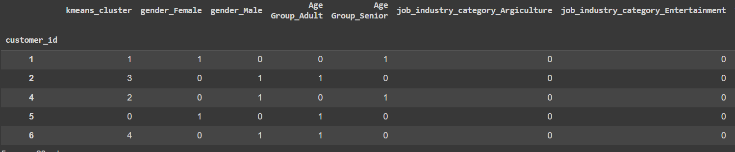

Recommender for New Customers
Required Data
Predictive Model
Clustering
Label Encoding
K-Means
Demographic data of old customers for clustering and demographic data of the new customer
Predicting what demographic cluster the new customer belongs in
Categorical
Numerical
Demographic Variables
One-Hot Encoding
A
B
C
A | B | C
0 | 1 | 0
1 | 0 | 0
1 | 1 | 1
Age Group
Wealth Segment
Grouping similar customers according to their demographic data
Gender
Job Industry
Categorical
Car Owner
State
0
1
Tenure Range
Binary

Slide 41
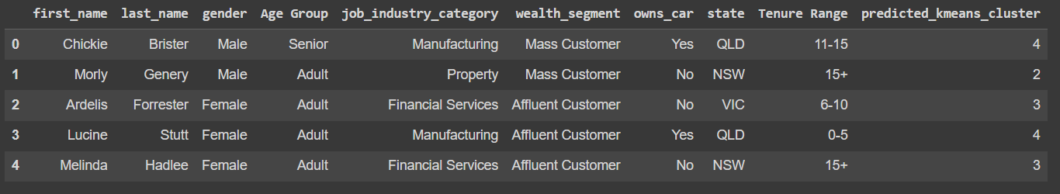
Recommender for New Customers
Required Data
Predictive Model
Clustering
Label Encoding
K-Means
Demographic data of old customers for clustering and demographic data of the new customer
Predicting what demographic cluster the new customer belongs in
Categorical
Numerical
Demographic Variables
One-Hot Encoding
SVM
Age Group
Wealth Segment
Grouping similar customers according to their demographic data
Gender
Job Industry
Categorical
Car Owner
State
0
1
Tenure Range
Binary

Slide 42
Recommender for New Customers
Required Data
Predictive Model
Clustering
Label Encoding
K-Means
Demographic data of old customers for clustering and demographic data of the new customer
Predicting what demographic cluster the new customer belongs in
Categorical
Numerical
Demographic Variables
One-Hot Encoding
SVM
Age Group
Wealth Segment
Grouping similar customers according to their demographic data
Gender
Job Industry
Categorical
Car Owner
State
0
1
Tenure Range
Binary

Slide 43
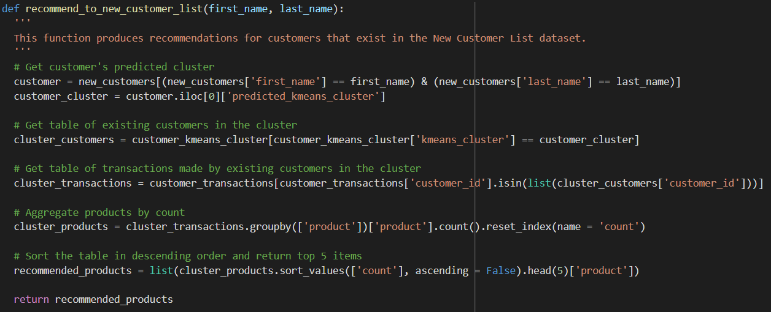
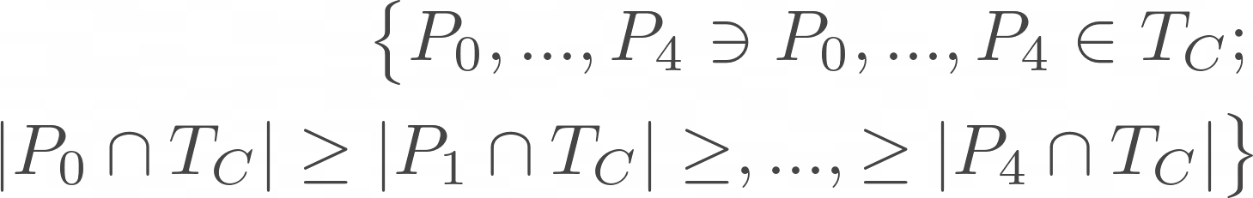
Recommender for New Customers
Filtering and Ranking
Take products purchased by customers in the same cluster with most number of transactions
1.

Slide 44





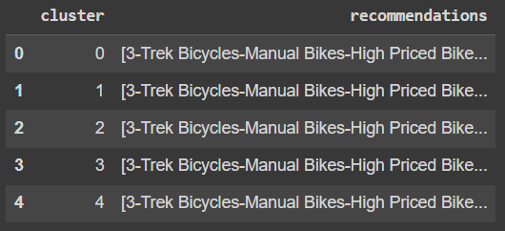
Recommender for New Customers
Filtering and Ranking
Output
Take products purchased by customers in the same cluster with most number of transactions
But it’s a bit biased!
The top 5 most popular products in the customer’s cluster will be recommended
Same top recommendation for all…
1.

Slide 45
Recommender for New Customers
Filtering and Ranking
Output
Take products purchased by customers in the same cluster with most number of transactions
But it’s a bit biased!
The top 5 most popular products in the customer’s cluster will be recommended
Same top recommendation for all…
1.

Slide 46



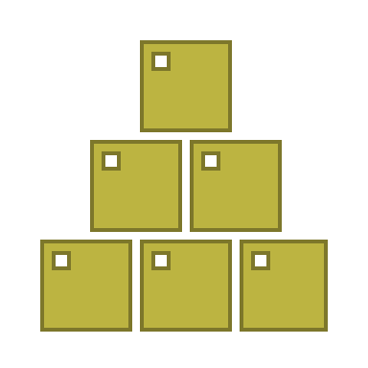


Recommender for Old Customers
Required Data
Customer Cluster
Product Cluster
[Clusters - 9]
[Clusters –
3, 4, 6, 7, 8]
Along with transactions, Product cluster, RFM Cluster and Demographic Cluster
Combination of Demographic and RFM Clusters to represent similarity to other customers
[Clusters - 0, 5]
[Clusters - 1, 2]
All Transactions
Available from the previous Product Segmentation section tp define similarity between products
Customer ID
Product
Transaction Date
Product
Cluster
Demographic
Cluster
RFM Cluster

Slide 47
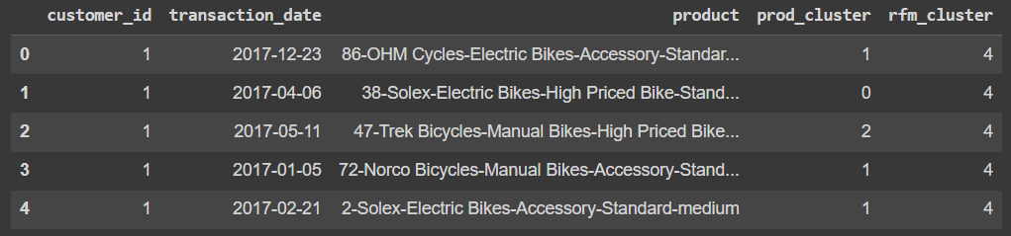
Recommender for Old Customers
Customer Cluster
Data
Product Cluster
Mercury is the closest planet to the Sun
Venus has a beautiful name, but it’s hot
Saturn is the ringed one and a gas giant

Slide 48
Filtering and Ranking
Output
It’s the biggest planet in the Solar System
Neptune is the farthest planet from the Sun

Slide 49
Cycle of the Whole Process
Mercury
Venus
Mars
Saturn
Neptune
Jupiter
Mercury is the smallest planet in the Solar System
Venus has a beautiful name, but it’s terribly hot
Despite being red, Mars is actually a cold place
It’s the biggest planet in the Solar System
Saturn is composed of hydrogen and helium
Neptune is the farthest planet from the Sun

Slide 50

—Someone Famous
This is a quote, words full of wisdom that someone important said and can make the reader get inspired.”
“

Slide 51

Customer Activity Tracker
05
How we can improve on

Slide 52
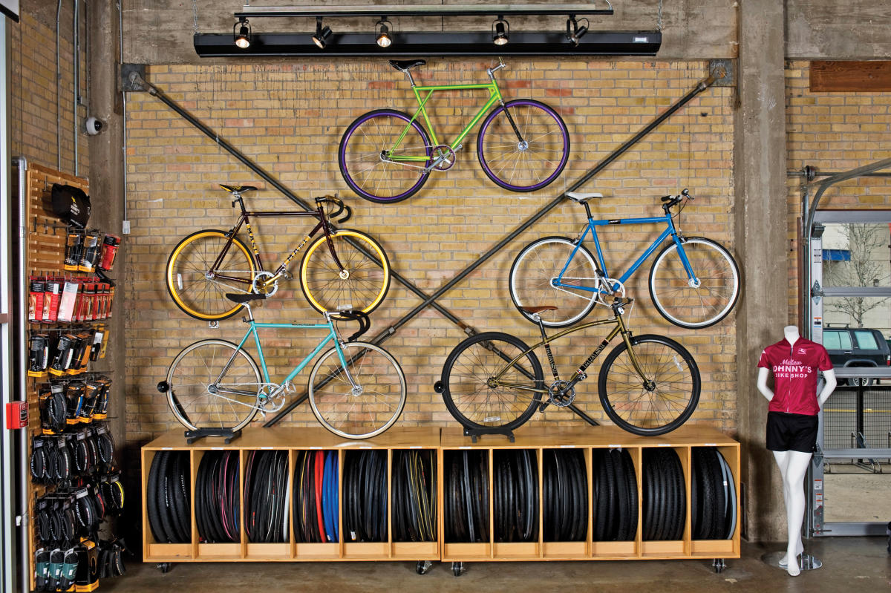
Thanks
Client Activity
Recommendations
Please keep this slide for attribution

Slide 53
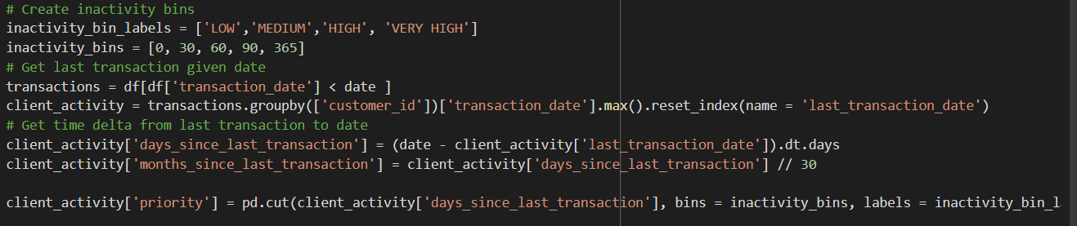



Generating Client Activity Table
Last Transaction Date
Days and Months Since Transaction
Priority Level
Important to know recency to see if we need to engage
Used to dictate the level of priority in engaging
Easy flagging to know how to approach the customer

Slide 54
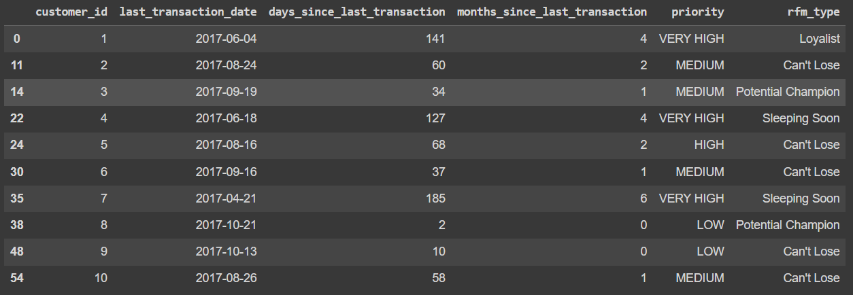
Generating Client Activity Table
Last Transaction Date
Days and Months Since Transaction
Priority Level
Important to know recency to see if we need to engage
Used to dictate the level of priority in engaging
Easy flagging to know how to approach the customer

Slide 55




The Evolution of the Recommendations
Demographic
Hybrid
Popular and Promo
Mercury is the closest planet to the Sun
It’s the biggest planet in the Solar System
Venus has a beautiful name, but it’s hot

Slide 56
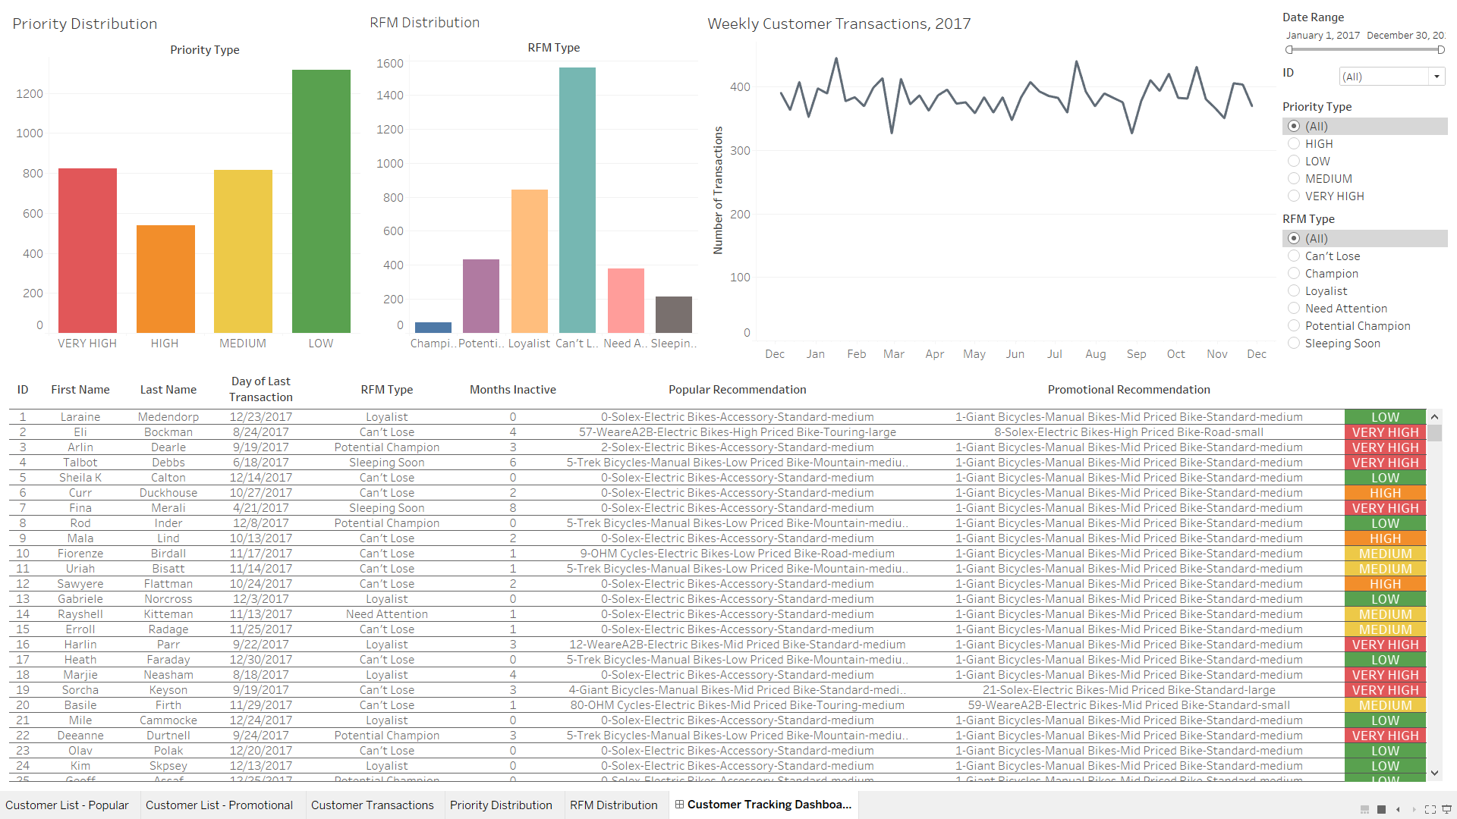
Sample Dashboard

Slide 57
Sample Dashboard
See the distribution of active and inactive customers
PRIORITY CONDITIONS [0, 30] – LOW [30, 60] – MEDIUM [60, 90] – HIGH [ 90, INF) – VERY HIGH

Slide 58
Sample Dashboard

Slide 59
Sample Dashboard

Slide 60
Sample Dashboard

Slide 61
Sample Dashboard

Slide 62
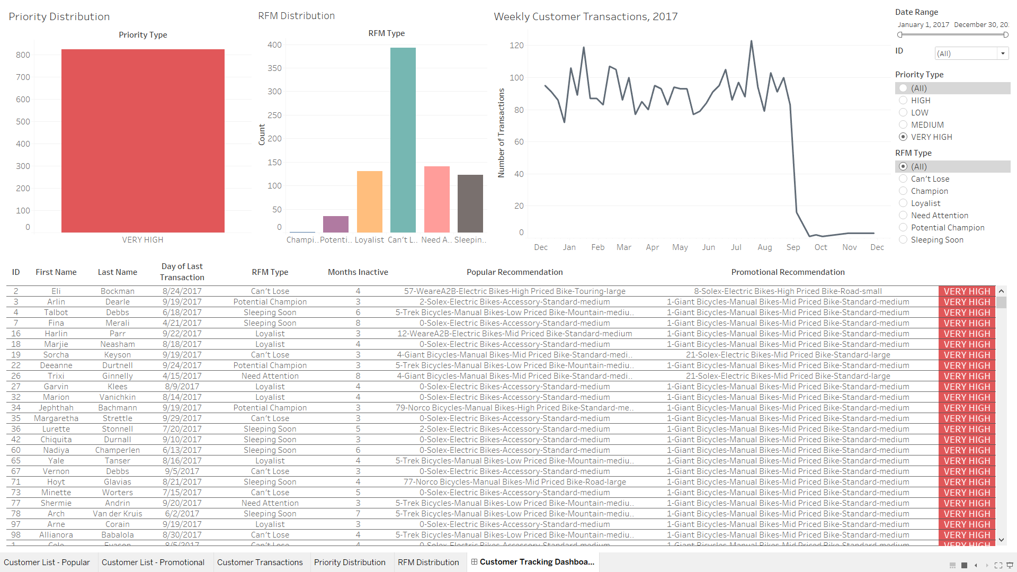
Sample Dashboard
Notes:
Look at who you need to hit up.

Slide 63
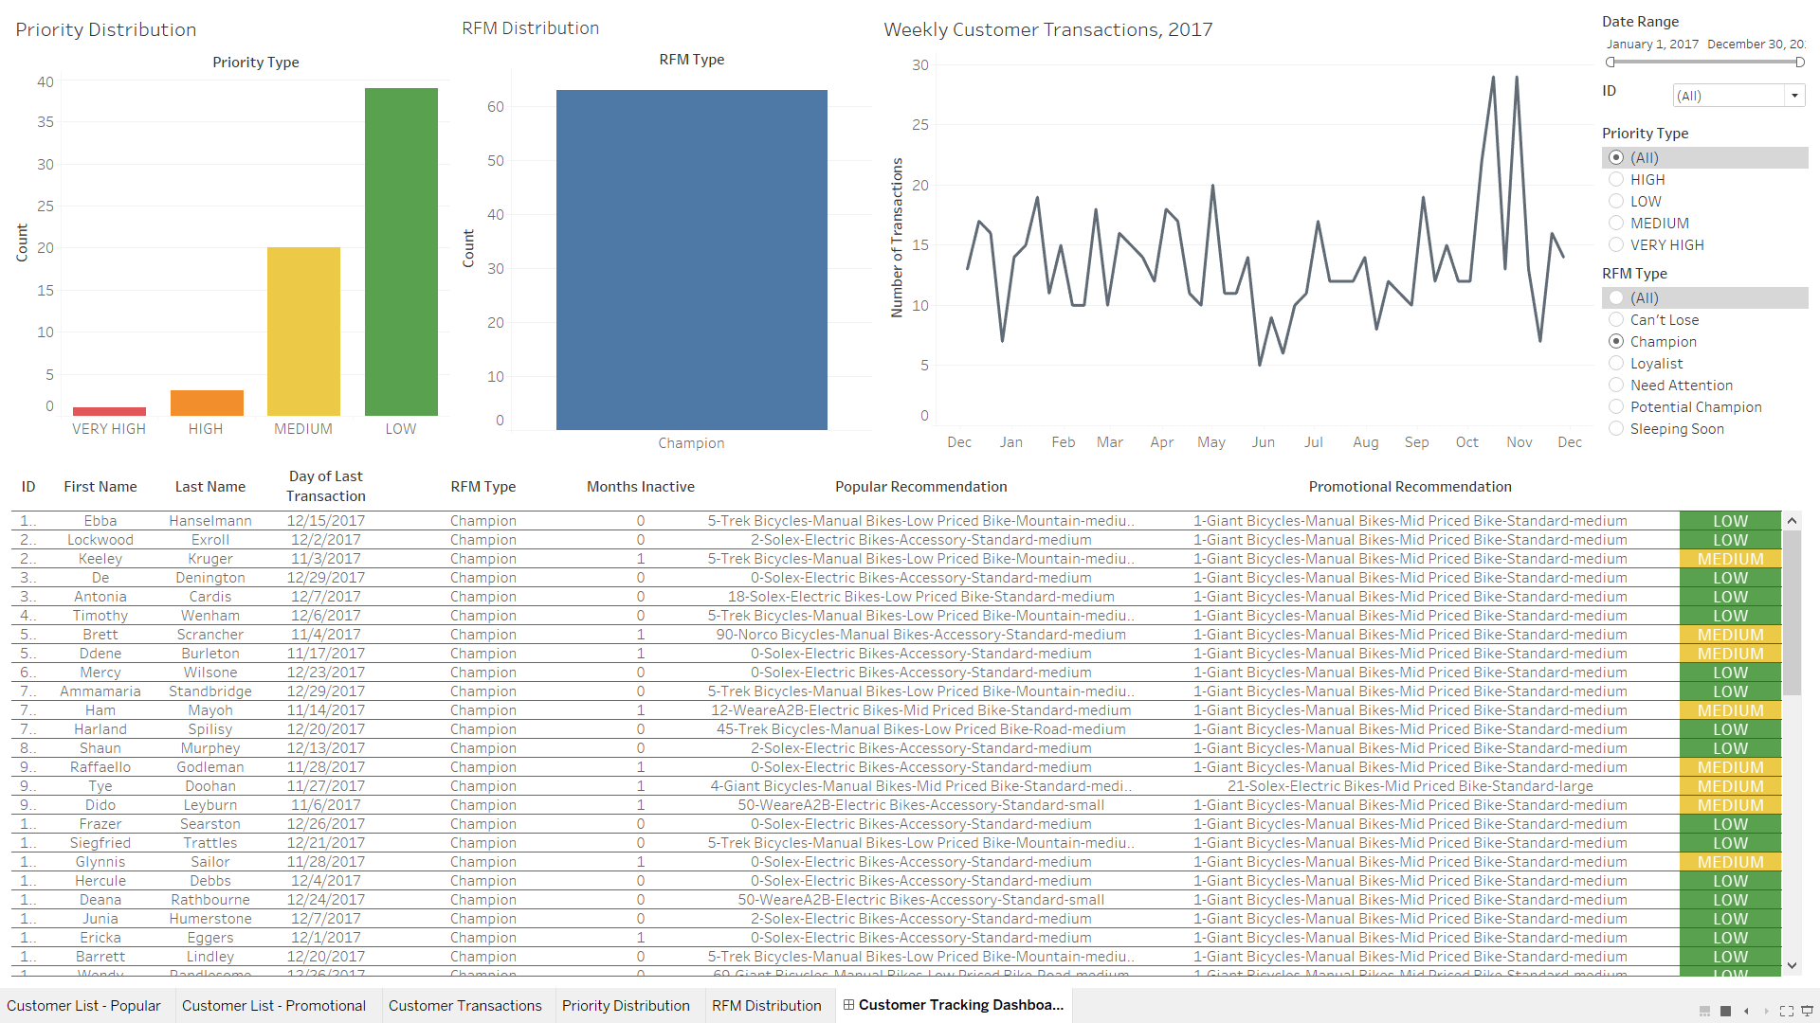
Sample Dashboard
Notes:
Look at who you should celebrate.

Slide 64
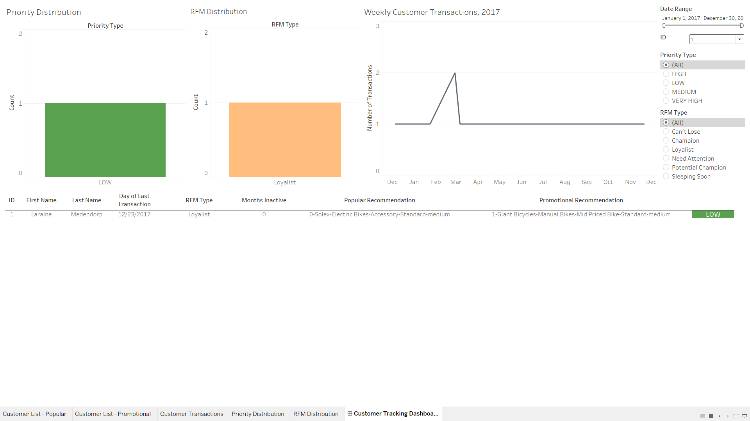
Sample Dashboard
Notes:
Customer-level check up. Consistent buyer every month.

Slide 65
Closed Loop Data Ecosystem
Data
Segmentation
Targeted Marketing
Recommender System
New Transaction
Customer Segmentation
Product Segmentation
New Customer

Slide 66

Thanks
Do you have any questions?
youremail@freepik.com
+91 620 421 838
yourcompany.com
Please keep this slide for attribution

